Slide 1
Year 11 Computer Science
Practical Programming

Slide 2
Essential Exercises to Do
1. Wanneroo Turf Farm
8. Just Friendly
15. Weather Max Temperature
22. Dice Throwing
30. Bubble Sort
2. Tony Riders Curtains
9. Liter Prize Day
16. Golfers Score
24. Reading a Text File (reading only)
31. Calculating an Area
3. Ace Autos
10. Jojo Disco
17. Australian Taxation Office
25. Lists
(reading only)
32. Circle Area & Circumference
4. Padbury Milk Deliveries
11. Total Scores
18. Wages Calculator
26. Lucky Dot Casinos
33. Paring String Values
5. Temperature converter
12. Various Tasks
19. Parcel Post
27. Mendez
34. Exam Mark
6. Lightening Flash
13. Ace Taxi Service
20. CD Manufacturer
28. Swap
35. Language Greetings
7. Number Adder
14. Loan Repayment
21. Addition Problems
29. Values Largest to Smallest
36. Dictionaries
(read and do)

Slide 3
Sequence

Slide 4
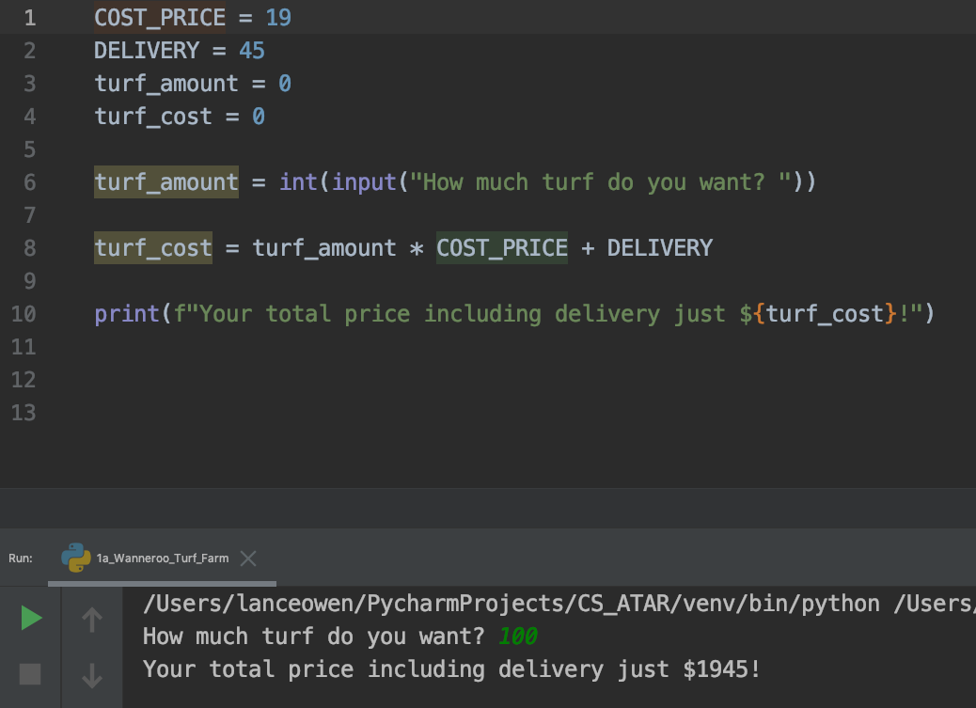
Wanneroo Turf Farm
Wanneroo Turf Farm sell instant lawn for $19 per square metre and charges $45 for delivery. A program is required to compute the charge for customers purchasing lawn and having it delivered.

Slide 5
Tony Rider’s Curtains
Tony Rider’s Curtains charge $28 per meter of material and a fixed charge of $105 when making
curtains for customers. A program is to be created to perform the calculations for Tony Rider.
First the number of meters is needed.
The cost can then be calculated by multiplying this by 28 and adding 105.
Complete a plan for this program to assist Tony Rider in the calculation of his customer’s
accounts.
Use the Turf Program as a guide to creating this program

Slide 6
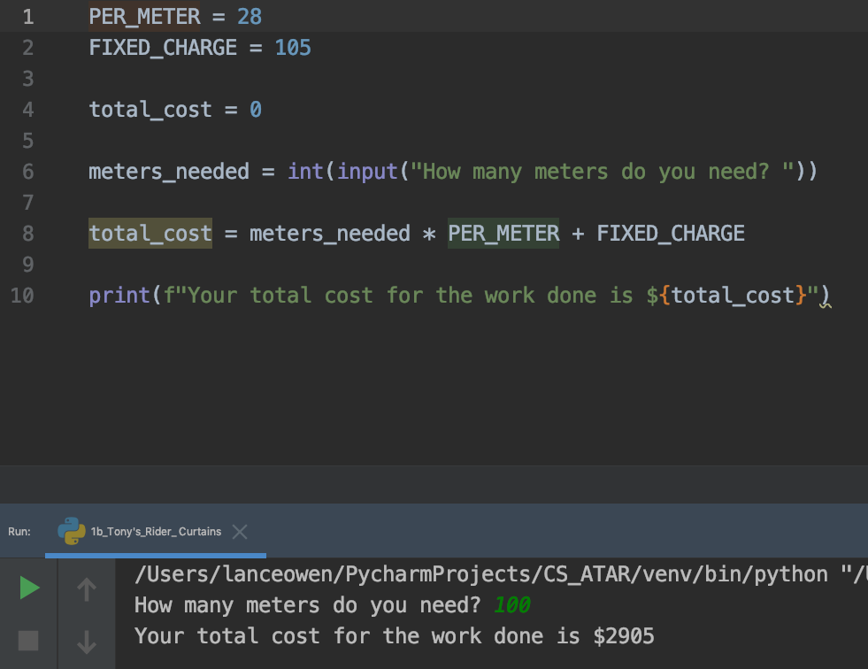
Tony Rider’s Curtains
Solution

Slide 7
Meat Metro
Meat Metro Works pays its employees a salary of $225 per week plus $25 per hour for every hour
worked during the week. Write a program htat will calculate the amount of pay owed to the
Metro Meat Works.

Slide 8
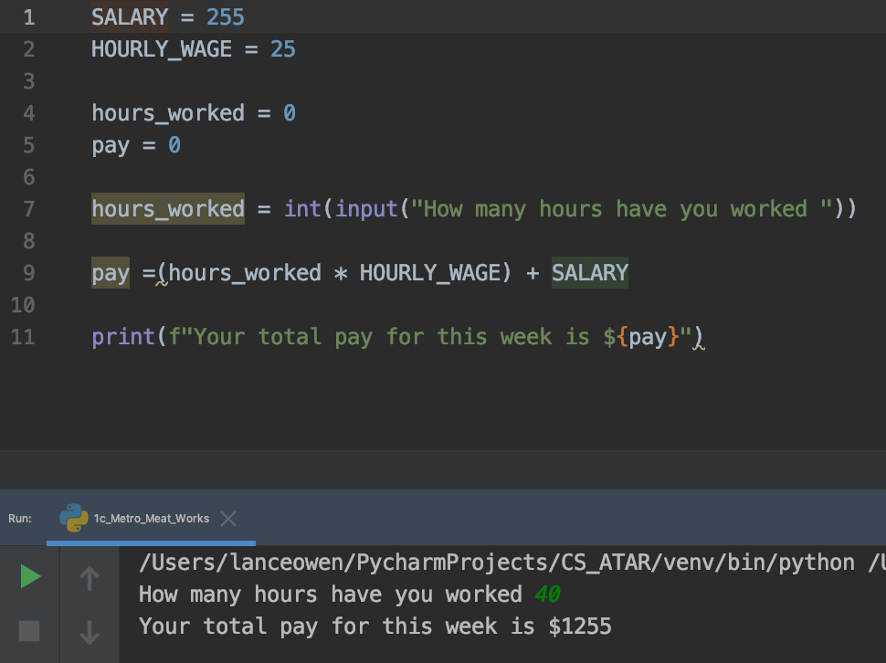
Meat Metro
Solution

Slide 9
Churchland Fencing Contractors
Churchland Fencing Contractors charges customers $74 per metre for Trim-Lock fencing and
$49 per metre to erect it. Churchland Fencing has contracted you to write a computer program
that will :
calculate the cost of supplying and installing a new fence.
Design and write the program that could be used for this purpose.

Slide 10
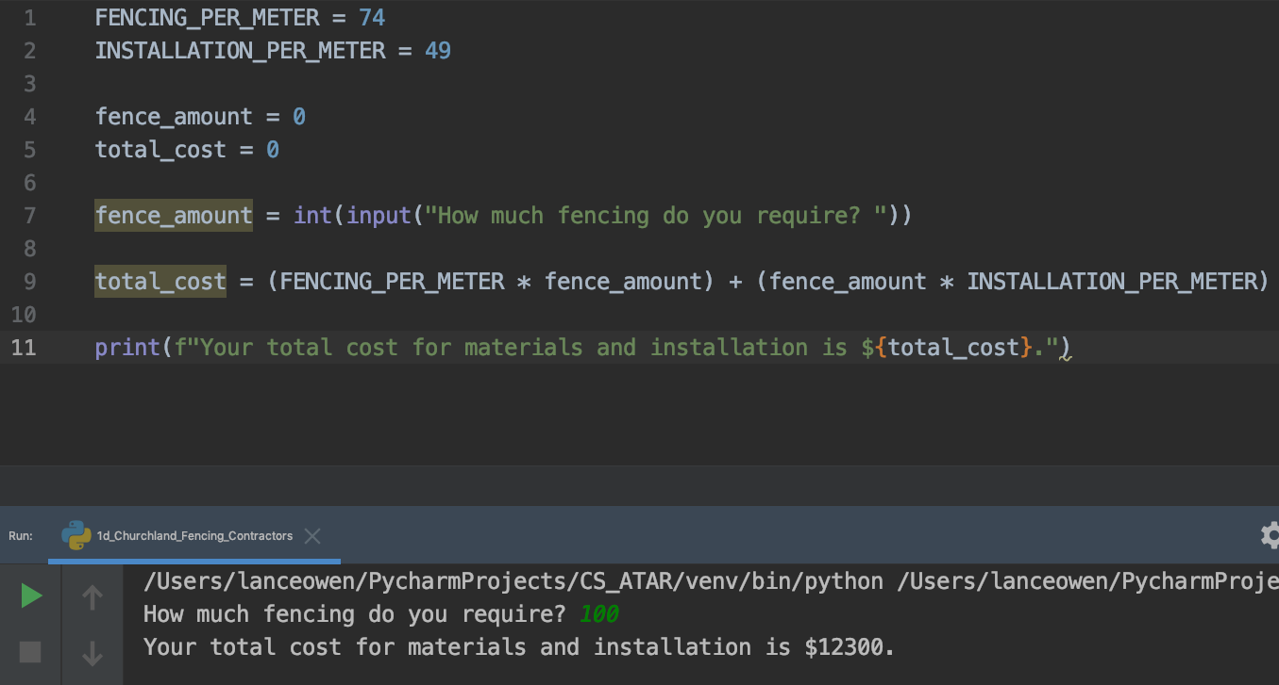
Churchland Fencing Contractors
Solution

Slide 11
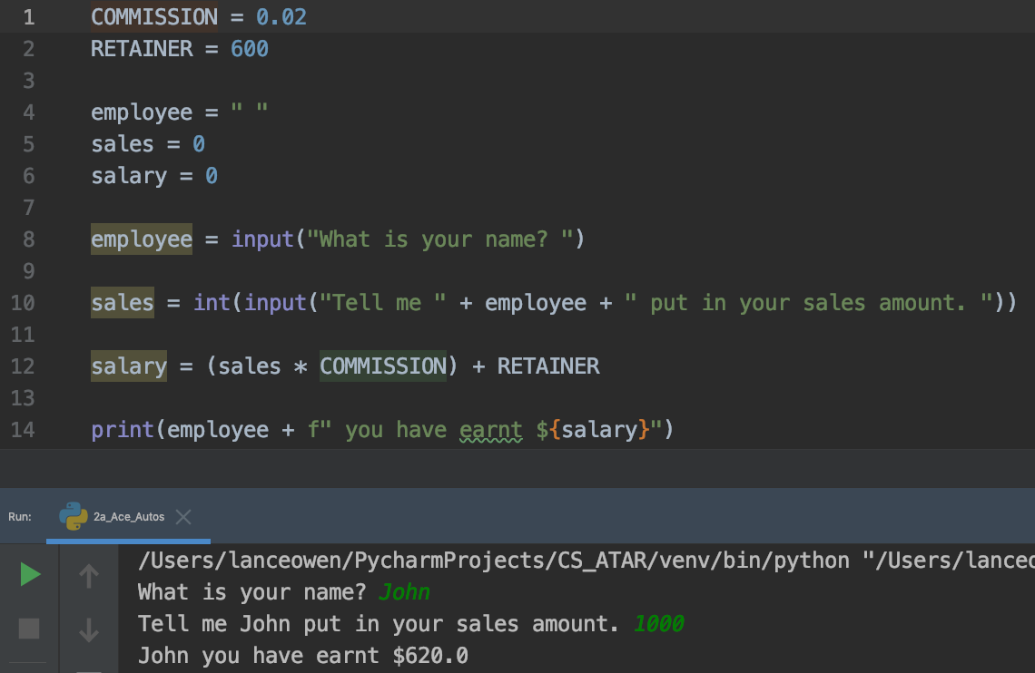
Ace Autos
Ace Auto’s pays its sales team a weekly retainer of $600 plus 2% commission on all sales made.
You have been commissioned to write a program that will allow the finance department to calculate the weekly salary for each sales person.

Slide 12
Padbury Milk
Padbury Milk delivers milk, cream and juice everyday to the people in Padbury. A weekly account
is made and delivered on each Friday. The prices are per carton of milk $2, cream $4 and juice $3
Write a program to accept :
the name of the customer
the number of cartons of each product per week
it must then calculate the total amount owing

Slide 13
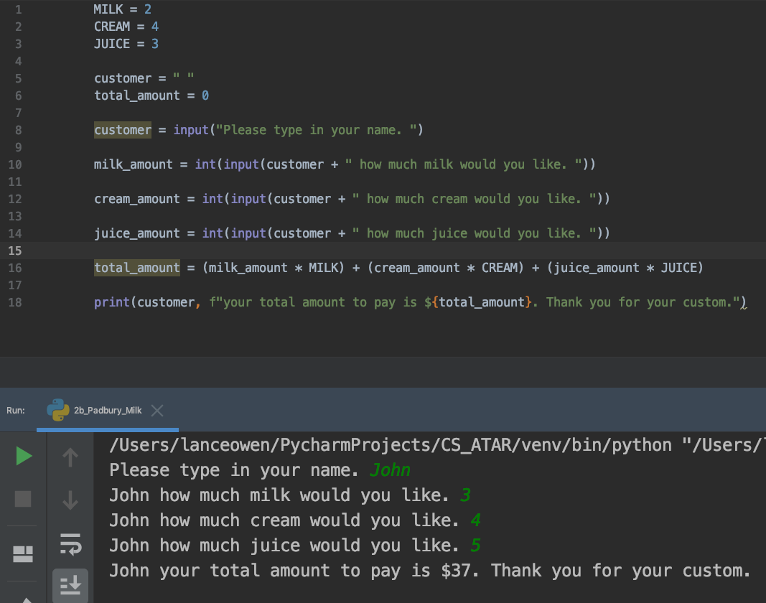
Padbury Milk
Solution

Slide 14
Paint-a-Drive
Paint-a-Drive is a paint that can be applied to driveways to renew the surface. Jone’s Painting
Services will paint a driveway for $15 a square meter and a set fee of $75. Mr Jones wants to have
A computer program to :
calculate the amount of Paint-a-Drive needed.
make a program that will accept the length and width of a driveway.
it must then calculate the area of the drive
determine the cost of painting the surface

Slide 15
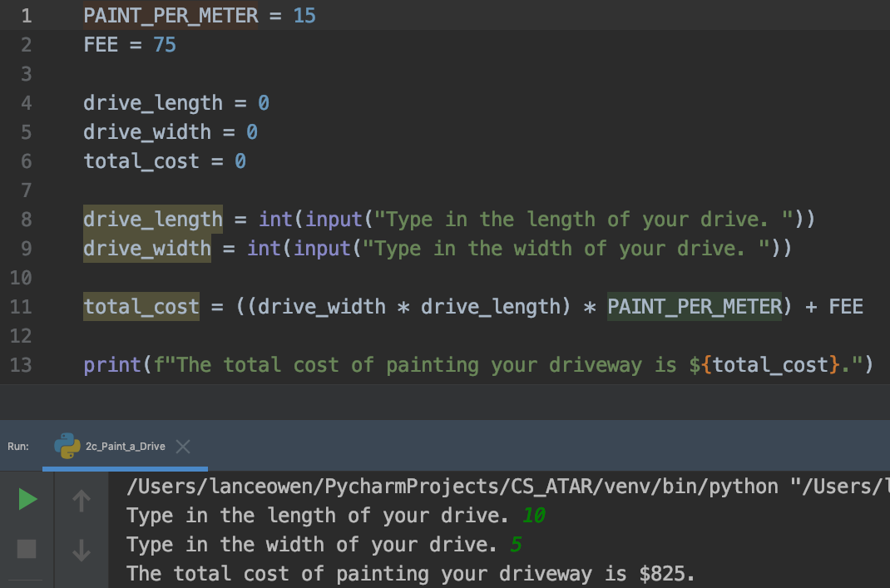
Paint-a-Drive
Solution

Slide 16
Fred’s Fencing
Fred’s Fencing erects multi-strand wire fences around small fields. Fred knows the length and
width of the field (in meters) and the number of strands needed. This will be a fence of six wires
Write a program for Fred so as he will know haw much wire he needs to buy to put up a fence.

Slide 17
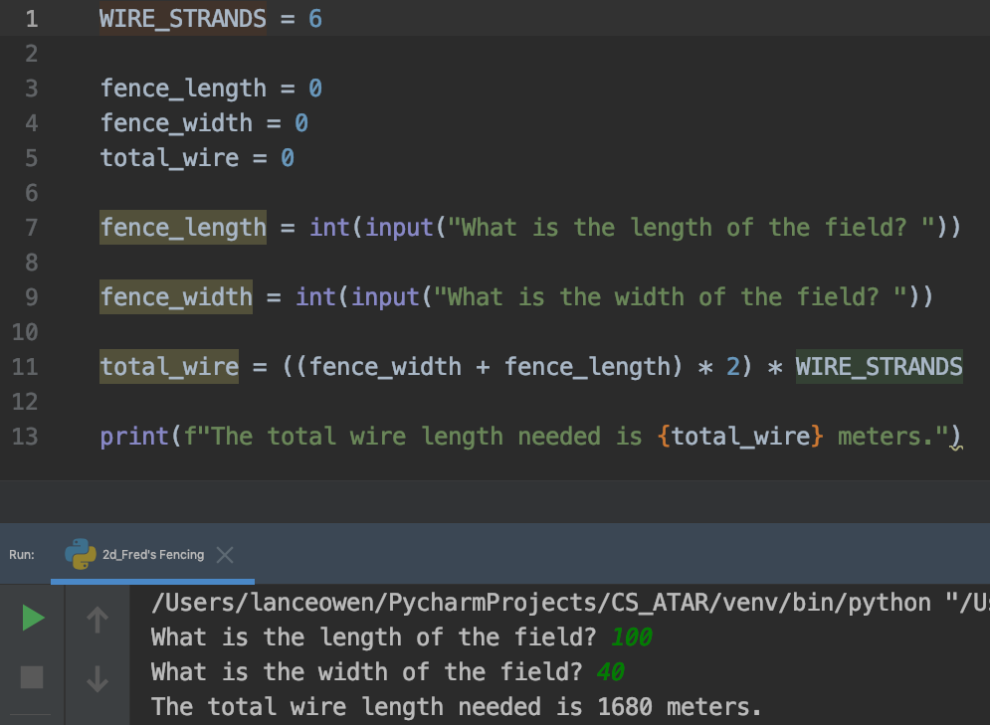
Fred’s Fencing
Solution

Slide 18
sliders

Slide 19
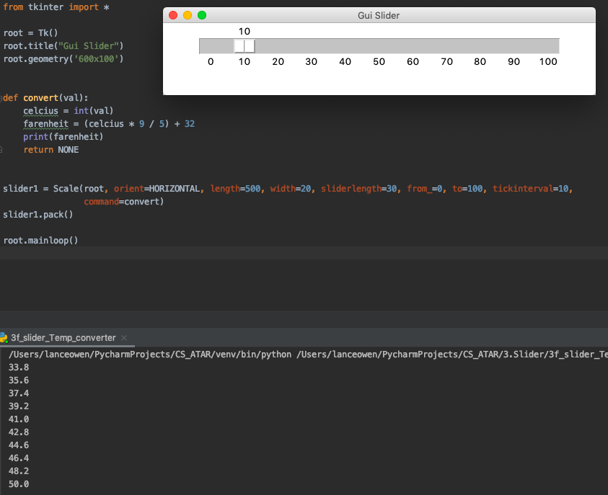
Temperature Converter
A program is needed to convert temperature in degrees Celcius to degrees Farenheit between
0 degrees C and 100 degrees C.

Slide 20
Lightening Flash
The time to hear thunder after a flash of lightening can be used to calculate how far away the l
lightening strike was. Given that the speed is 340 meters per second in air, write a program that
will calculate how far a lightning strike is if the time to hear thunder is given in seconds

Slide 21
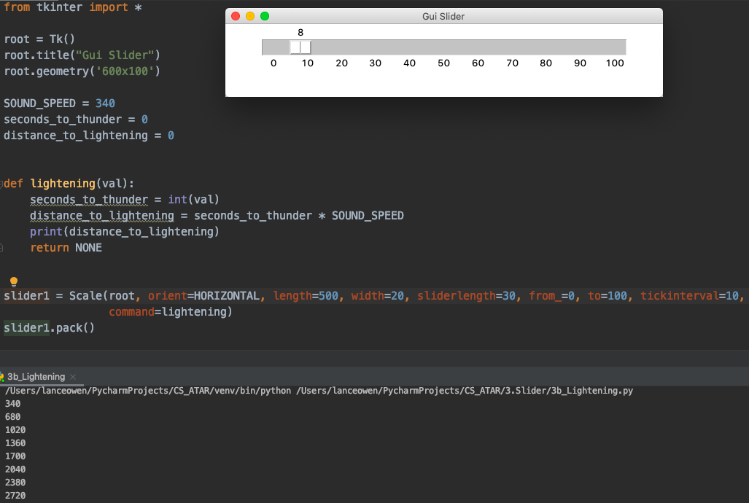
Lightening Flash Solution

Slide 22
Jan’s Lollie Shop
Jan’s Lollie Shop sells Smarties by the gram and each gram contains 6 Smarties. They also cost
10 cents a gram. Many children want to know how many Smarties they are getting. Write a
program to show the number of Smarties and the price to be paid.

Slide 23
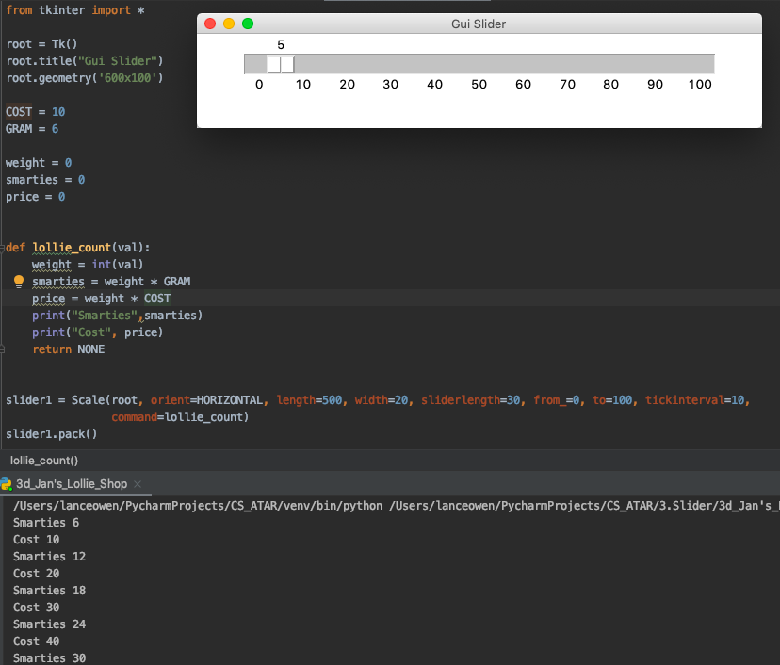
Jan’s Lollie Shop Solution

Slide 24
Measurement Conversion
Diagrams that come from the United States have measurements in inches. A program is needed
To take measurements in inches and to convert them to centimeters.
Note: 2.54 centimeters = 1 inch

Slide 25
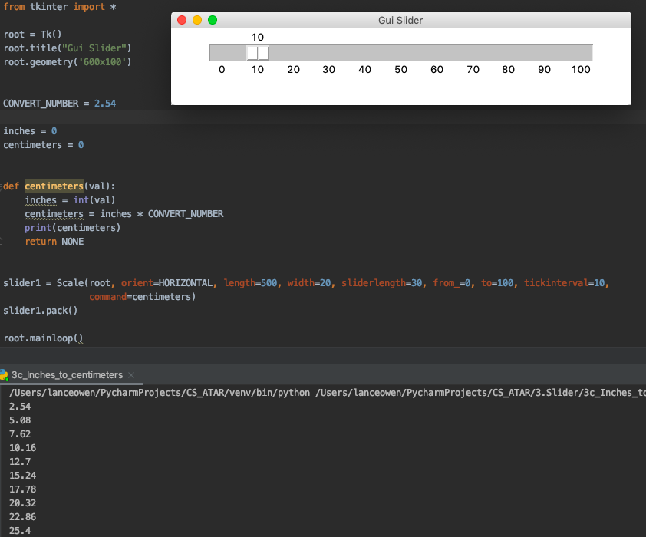
Measurement Conversion Solution

Slide 26
Exchange Rate
If you want to buy goods on the Internet, you often have to buy them in the currency of the
country for where you are buying. The exchange rate is used to refer to the amount of money
which one Australian dollar is worth in another currency and this continually changes.
For example $A1 may be worth 74c US one day and due to economic changes 77c US several days
Later. Plan and write a program which will allow you to convert a price in some other currency to
Australian dollars. The current rate of exchange will need to be entered

Slide 27
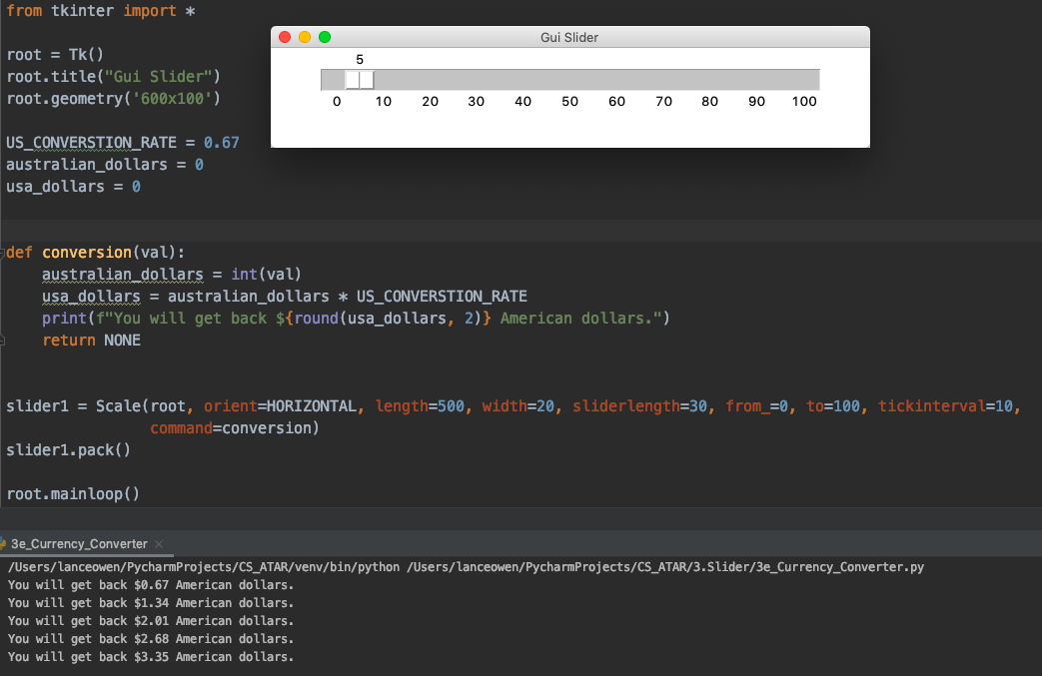
Exchange Rate Solution

Slide 28
Repetition: while loop

Slide 29
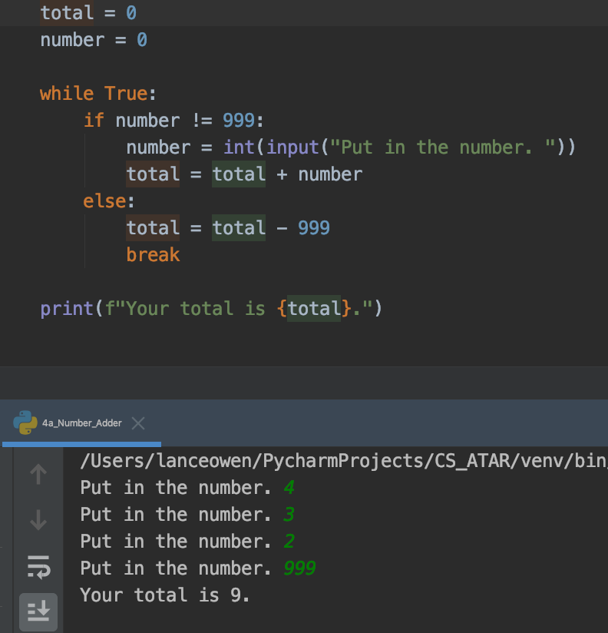
Number Adder
A program is needed that will add, if necessary, a set of numbers. To determine when all of
the required numbers have been entered, the number 999 is entered. This is not included in
the addition. The total of the entered numbers is then displayed. The number 999 is called a sentinel.

Slide 30
Just Friendly Supermarket
“Just Friendly” supermarket chain ask you to write a program that will let the checkout operator enter the cost of a customer’s grocery items and calculate the total.
When -1 is entered, the program calculates the Goods and Services tax rated at 12.5% and adds this to the total to give a final total.
The pretax total, amount of tax and the final total are to be displayed.

Slide 31
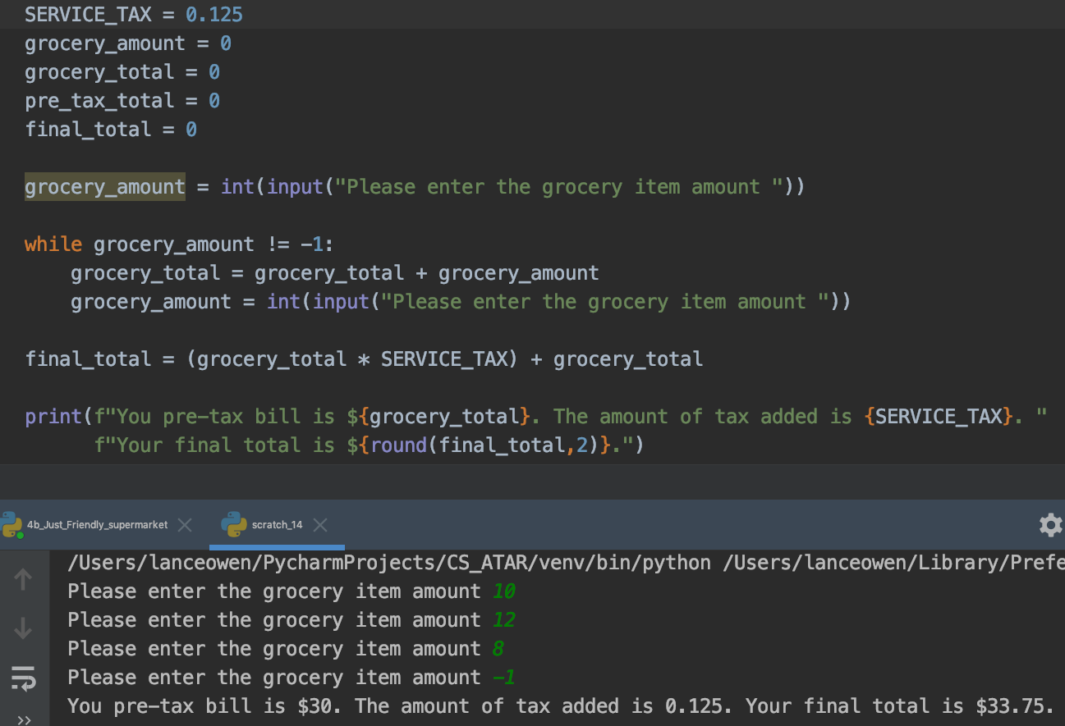
Just Friendly Supermarket
Solution

Slide 32
Just Friendly Supermarket with average
Modify the Just Friendly supermarket exercise you have just done and calculate the average of the numbers entered. To calculate the average the program must count how many numbers are entered. Use a variable Count and the following code.
count = count + 1
To count how many numbers are entered. Don’t forget to set count to zero at the start.

Slide 33
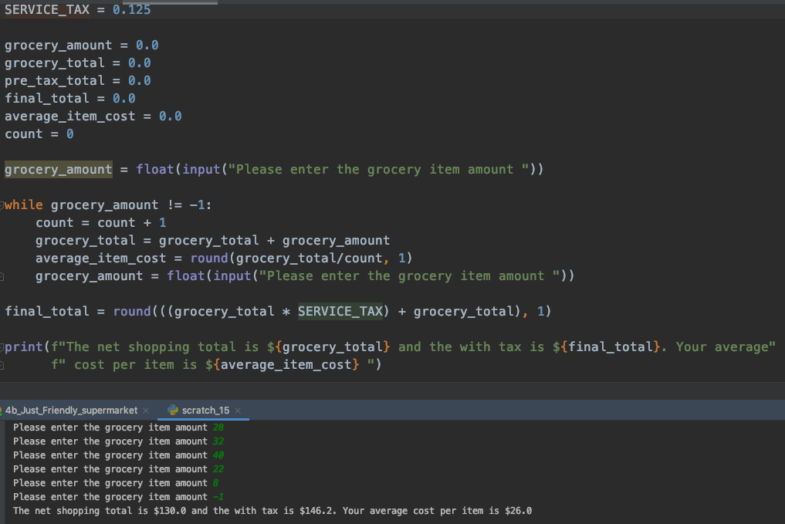
Just Friendly Supermarket with average
Solution

Slide 34
Guessing Game
A guessing game program is needed to test the intelligence of students. The WHILE loop is ideal for this as the user may guess the number first off. Write a computer program that continues to ask the student to guess a number between 1 and 100 until the secret number is guessed. If the guess wrong, display a message ”Bad Guess - Try again.” When they guess the correct number, display the message “You guessed it!” and stop the program.

Slide 35
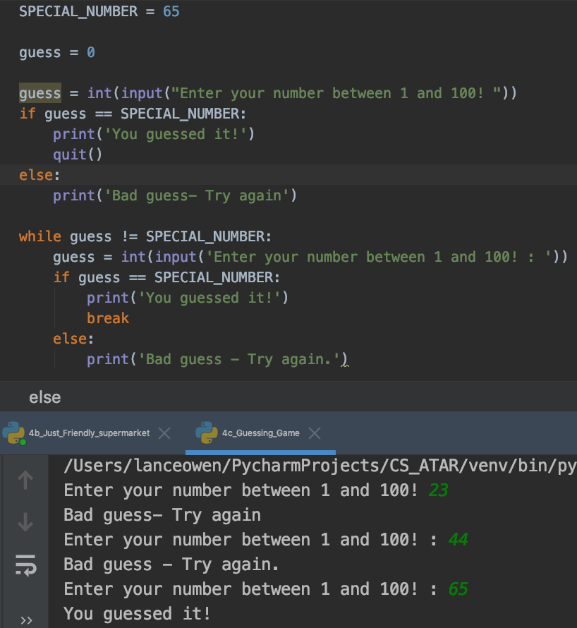
Guessing Game
Solution
Guessing Game
Solution

Slide 36
Guessing Game extension
Extension to the Guessing Game is to make your program count the number of guesses taken.

Slide 37
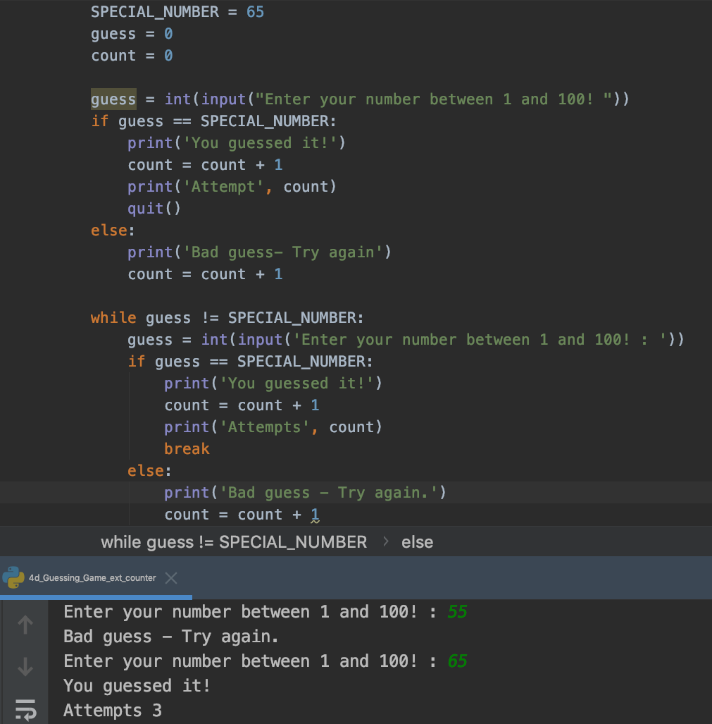
Guessing Game extension
Solution

Slide 38
Repetition continued

Slide 39
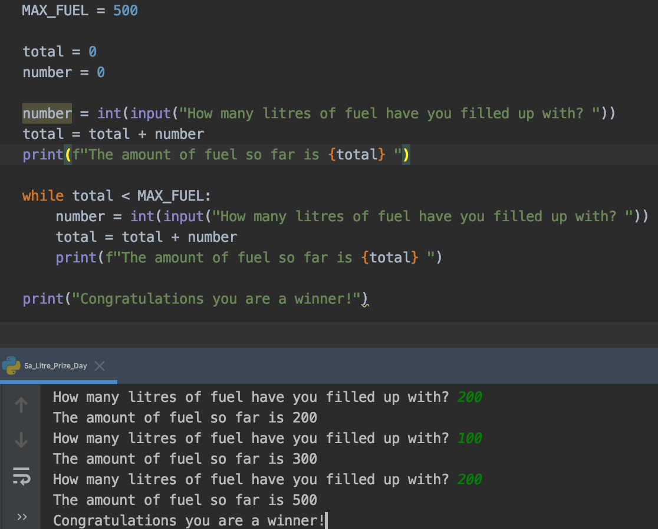
500 Liter Prize Day
As an introductory offer to all customers of the new Rottnest Fuel Boat refilling station. The customer who purchases fuel during the time the 500th liter is pumped will win a prize. You have been contacted by Rottnest Fuel to write a program that allows the attendant to enter the fuel used by each customer and then announce the time when 500 liters' is reached or exceeded.

Slide 40
JOJO disco
JOJO disco can only hold 1000 people. The customers usually come in groups. Write a program
that will allow the JOJO door-keeper to enter the number of each group and tell him when the
limit has been exceeded.

Slide 41
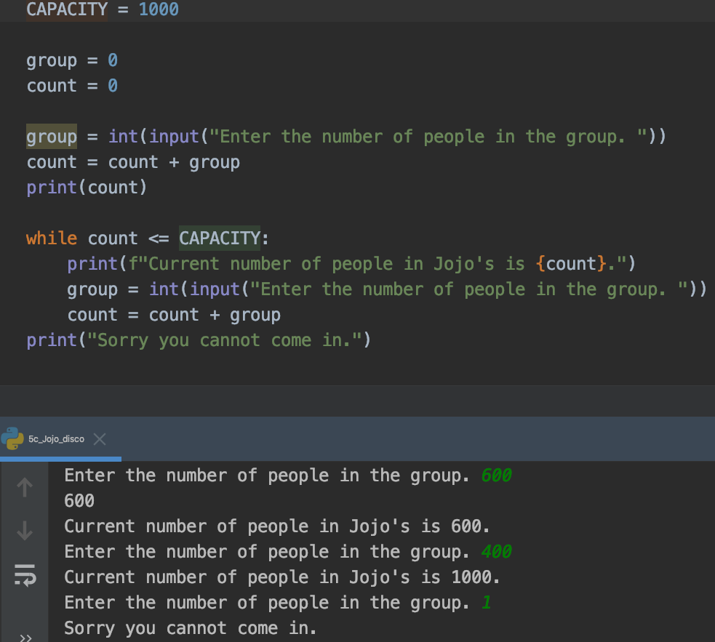
JOJO disco
Solution

Slide 42
Bunnings Hardware
Bunnings hardware needs a program that will allow stock control of a paint sale where 80 cans
of paint are available. Write a program that will allow the check out operator to enter the number
of cans purchased and advise when no more paint is left

Slide 43
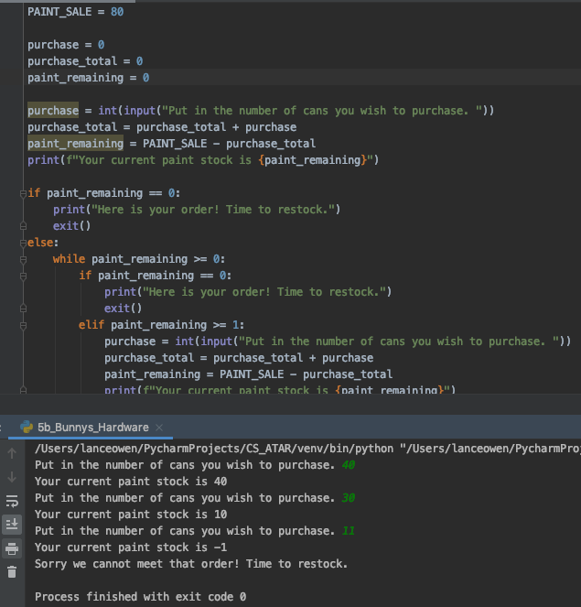
Bunnings Hardware
Solution

Slide 44
Random Numbers Inc
Random Numbers Inc wants a program that will simulate a die being thrown (the numbers are from
1 -12. The idea is that the user enters the number they want to throw and then bet on how many
throws it takes to get the number. You have been contracted to write this program. You will need to
use two pieces of code:
from random import randint
dice_1 = randint(1, 12)
You will need a loop and an input () function to simulate the die being thrown. The die continues to
be thrown until the selected number is obtained and report how many throws it took to get it.

Slide 45
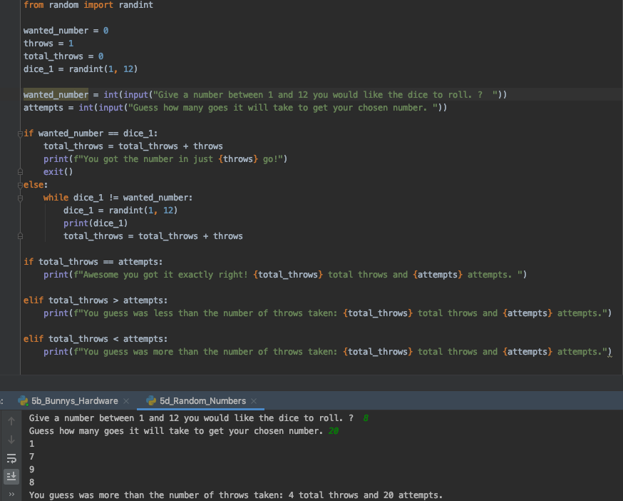
Random Numbers Inc
Solution

Slide 46
Repetition: FOR LOOP

Slide 47
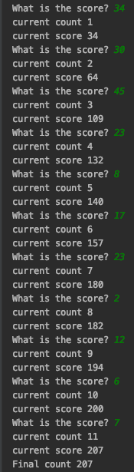
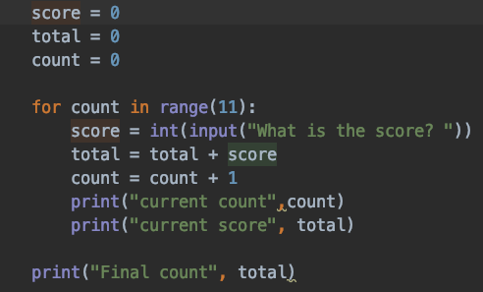
Total Scores
You have been contracted to write a program that will calculate the total of the scores of the11 players in the Wanneroo cricket team.

Slide 48
Various Tasks
Create as series of small programs to demonstrate each of the following.
Print the integers from 1 to 100
Print the even numbers from 2 to 200
Count down from 100 to 1
Counts from any start number to any finish number counting up or down by any step size
Add the numbers from 1 to 100
Print any number of smily faces ☺ required by the user

Slide 49
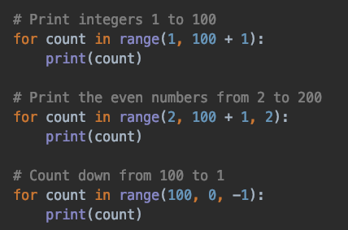
Various Tasks
Solutions

Slide 50
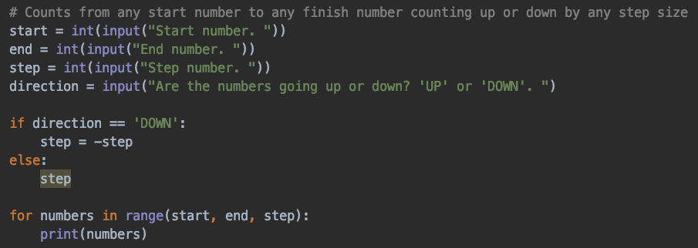
Various Tasks
Solutions

Slide 51
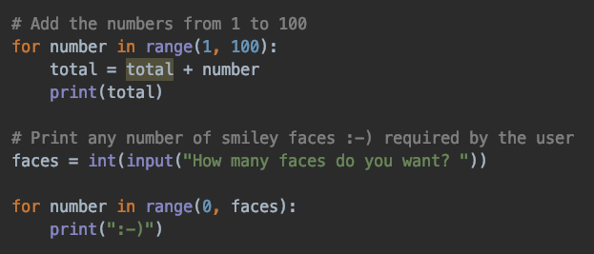
Various Tasks
Solutions

Slide 52
Rainfall measurement
You have been contracted to write a program that will accept from the user the rainfall
(in Millimeters) for each day of the week and then show total and average rainfall for the week.

Slide 53
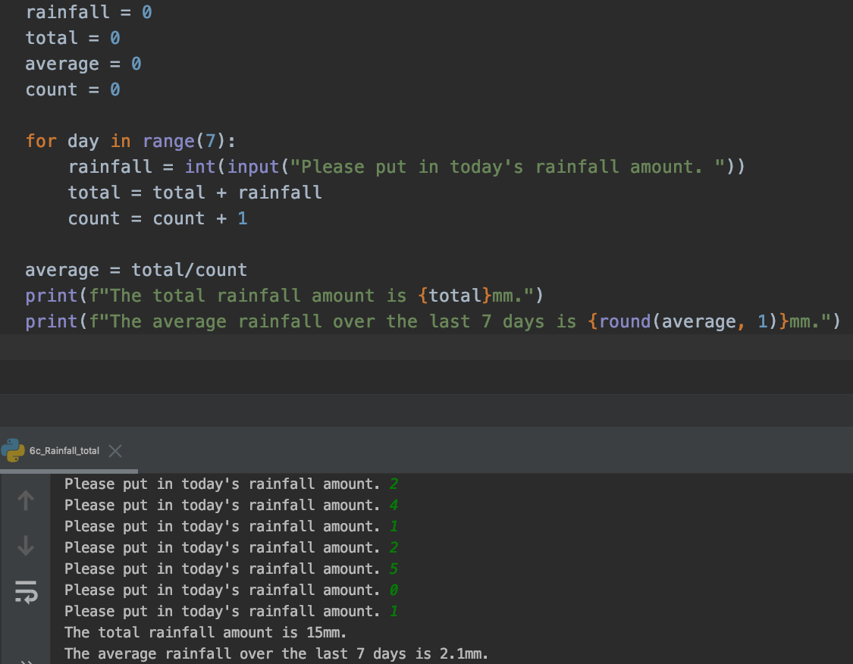
Rainfall measurement
Solutions

Slide 54
Factorial values
Factorial values of a number are calculated by multiplying the number and all the numbers before
it together. So 5 = 5 x 4 x 3 x 2 x 1.
Write a program that will calculate the factorial numbers from 2 to 10 and print them out.

Slide 55
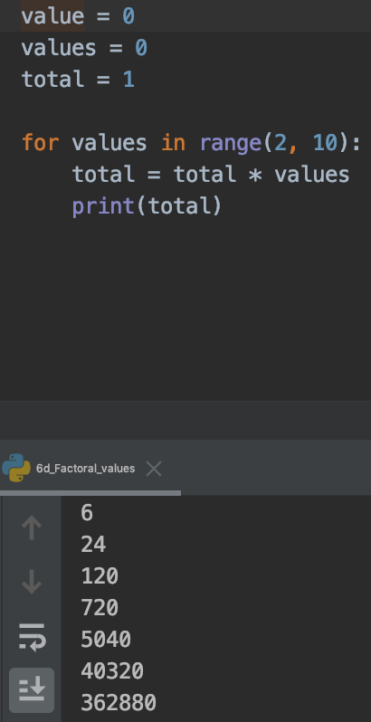
Factorial values
Solutions

Slide 56
More For repetition loops

Slide 57
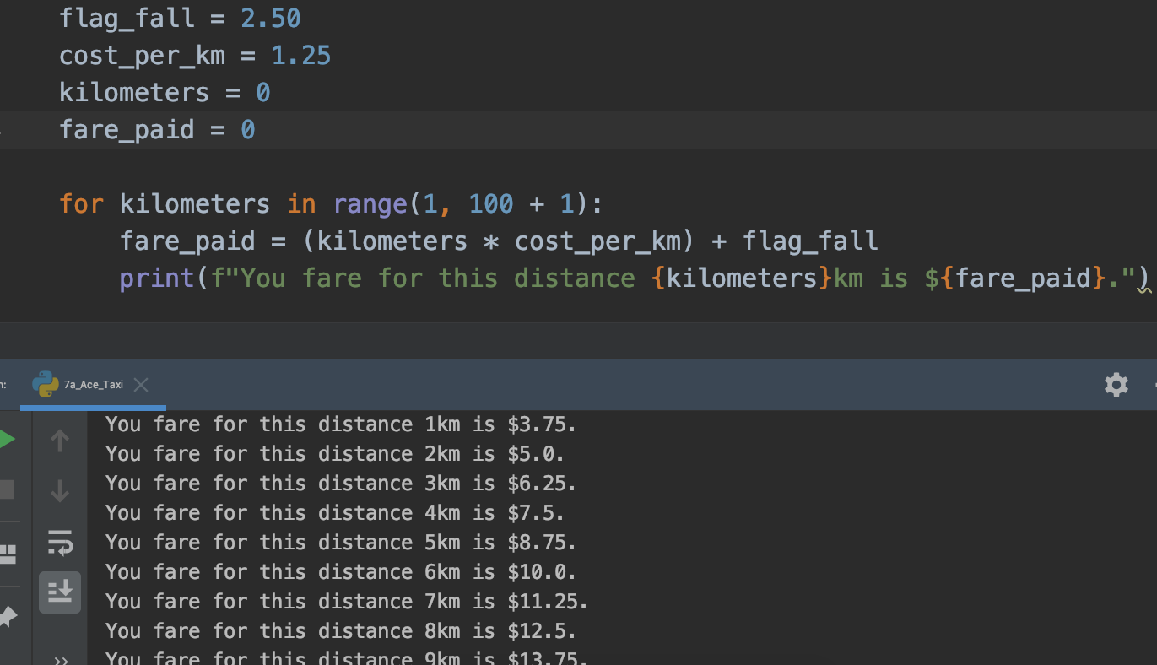
Ace Taxi
You have been contracted by Ace Taxi Company to produce a program that will make a list of charges based on distance travelled.
The current charges are $2.50 flag fall plus $1.25 per kilometer travelled. You program will need to display the are paid for distance form 1 to 100

Slide 58
Loan repayment
Write a program that will show the amount owing for a loan of $100 if the monthly
repayments are $10 and the interest rate is 5%.

Slide 59
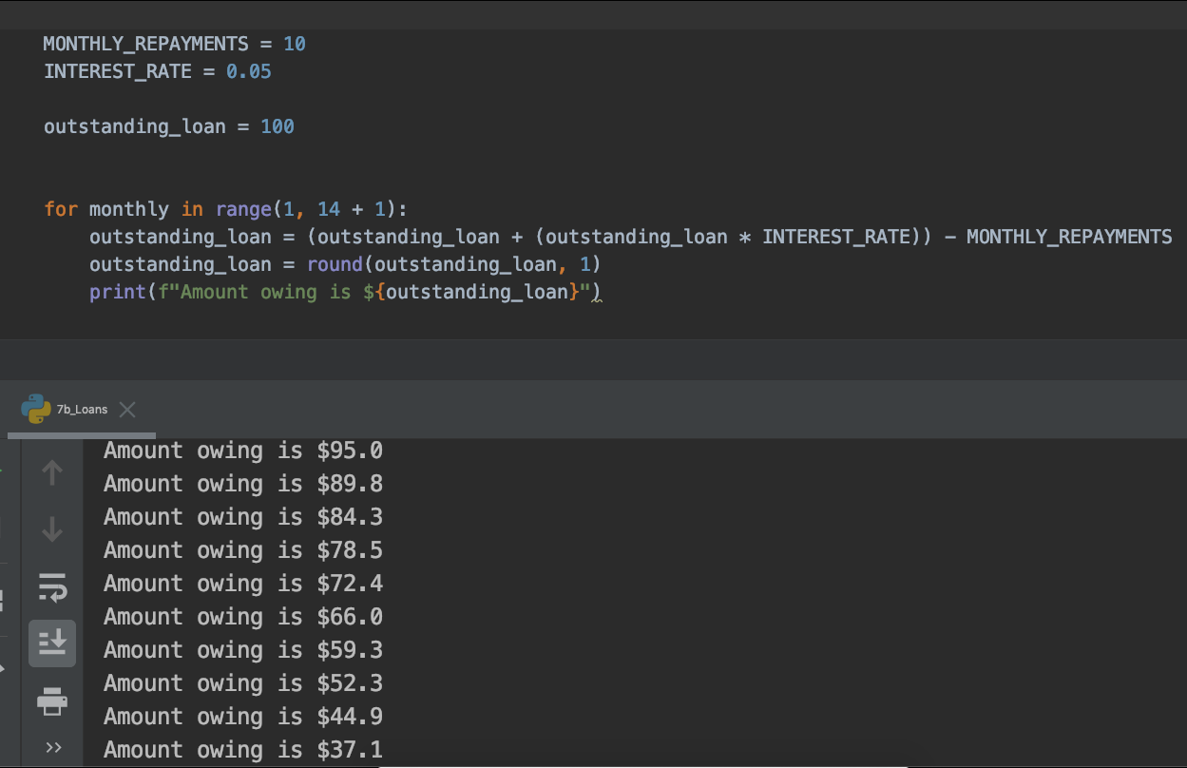
Loan repayment
Solution

Slide 60
Fixed Interest
Write a program that will shown the amount of money at the end of each year in a
fixed interest bank account over a period of 100 years. Assume that the interest rate
is 5% per annum. The interest is added to the principle at the end of each year to make
The new principal.

Slide 61
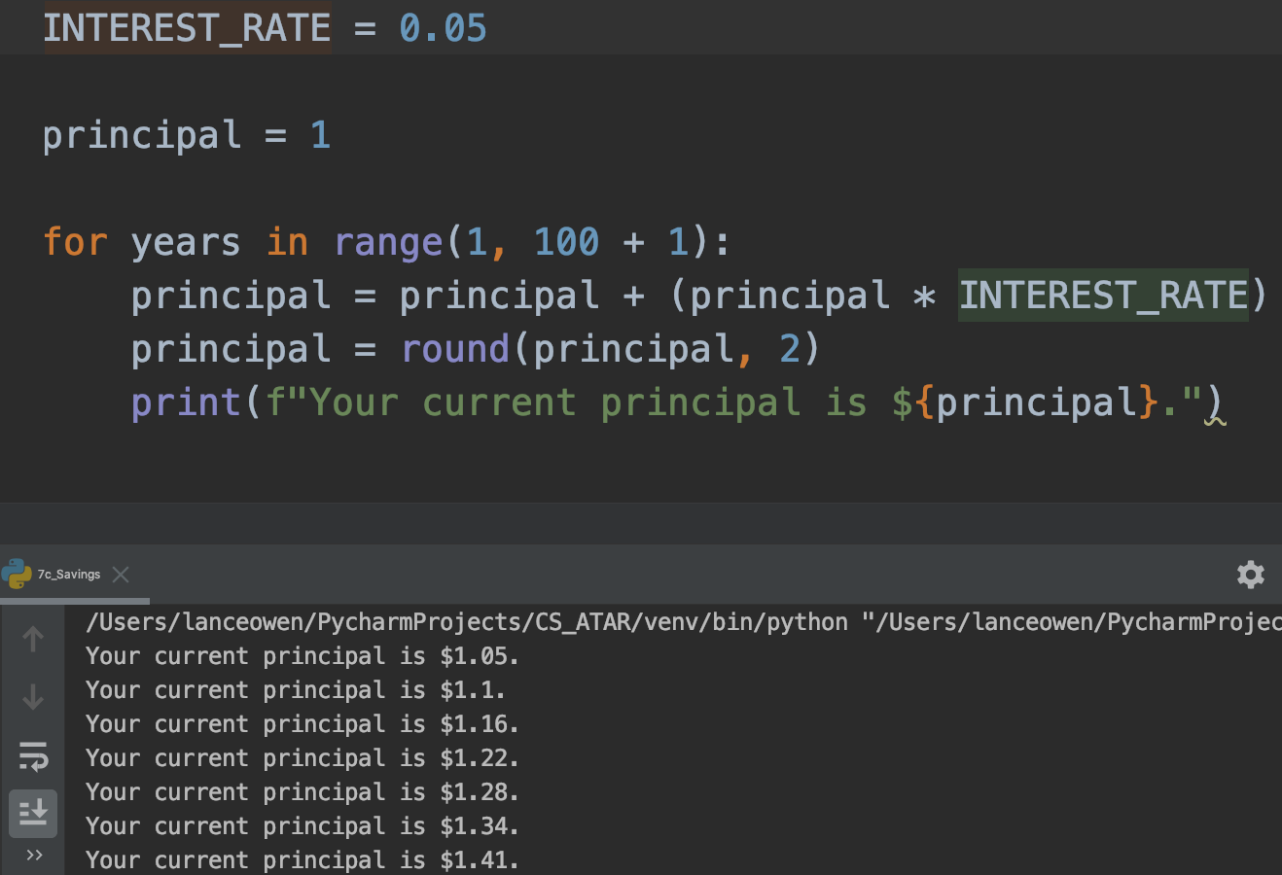
Fixed Interest
Solutions

Slide 62
If then

Slide 63
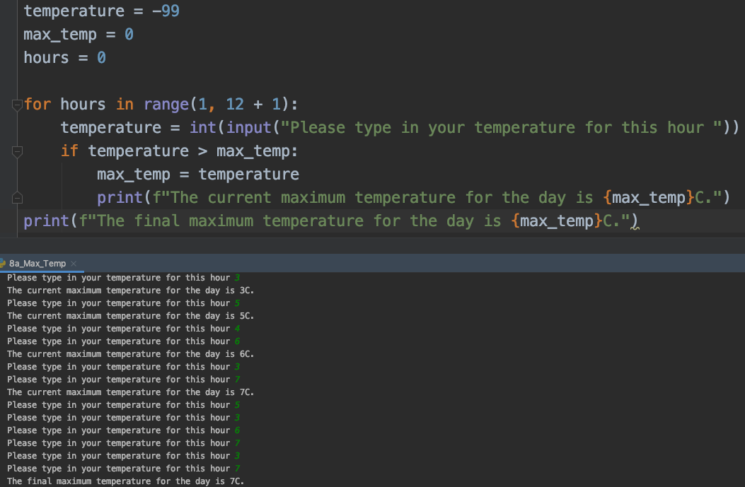
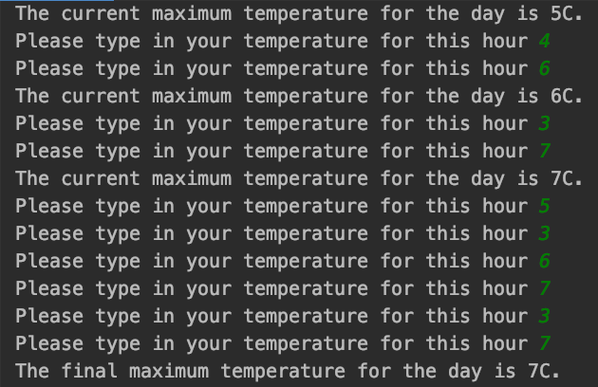
Max Temperature
A student has a Social Science project for which the maximum termperature for a day must be found.
The student goes to the Bureau of Meteorology every hour and downloads the temperature for Perth
throughout the day . You are to create a program that will accept the temperatures downloaded over the day (a 12 hour period) and determine the maximum temperature

Slide 64
Golfers score
You are to make a program to enter the scores of golfers in a tournament. To show the winning
lowest score a value of 999 is entered.

Slide 65
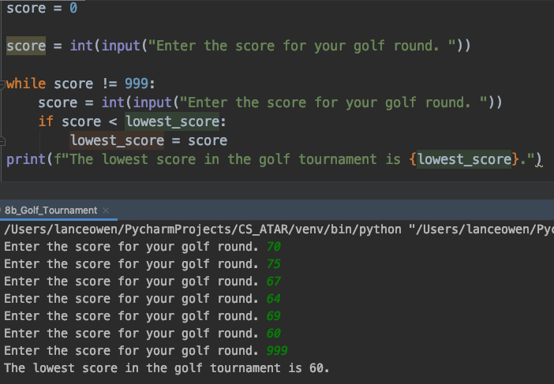
Golfers score
Solution

Slide 66
Class range of marks
You have been contracted by a school to create a program that can be used to calculate the
range of marks for students in a class. All classes have 15 students. (Note range is the difference
between the highest and lowest scores.

Slide 67
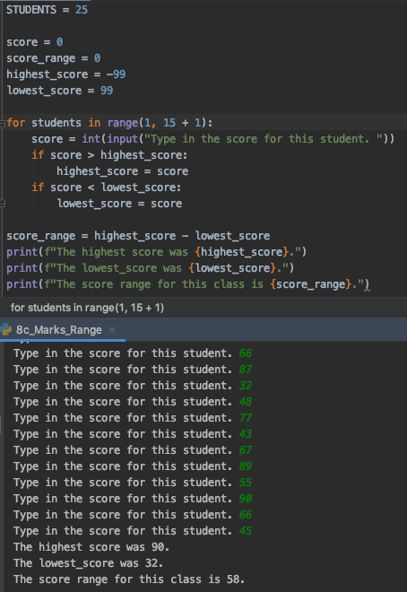
Class range of marks
Solution

Slide 68
World Diving Championships
In the diving competition of the World Diving Championship, 7 judges award a score to each
competitor. So as the judging will be fair, a diver’s final score is calculated by deducting the
highest and lowest score after adding all of the scores together. You have been asked to
create a program that could be used to calculate the scores.

Slide 69
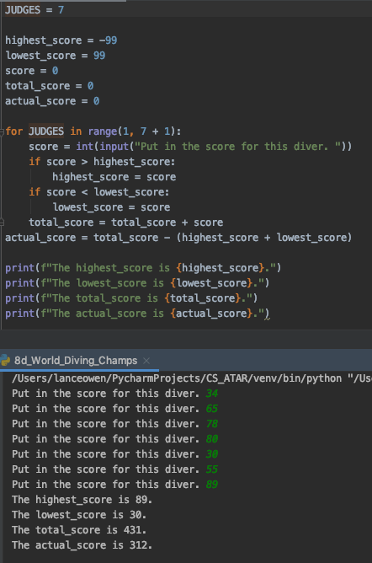
World Diving Championships
Solutions

Slide 70
If then else

Slide 71
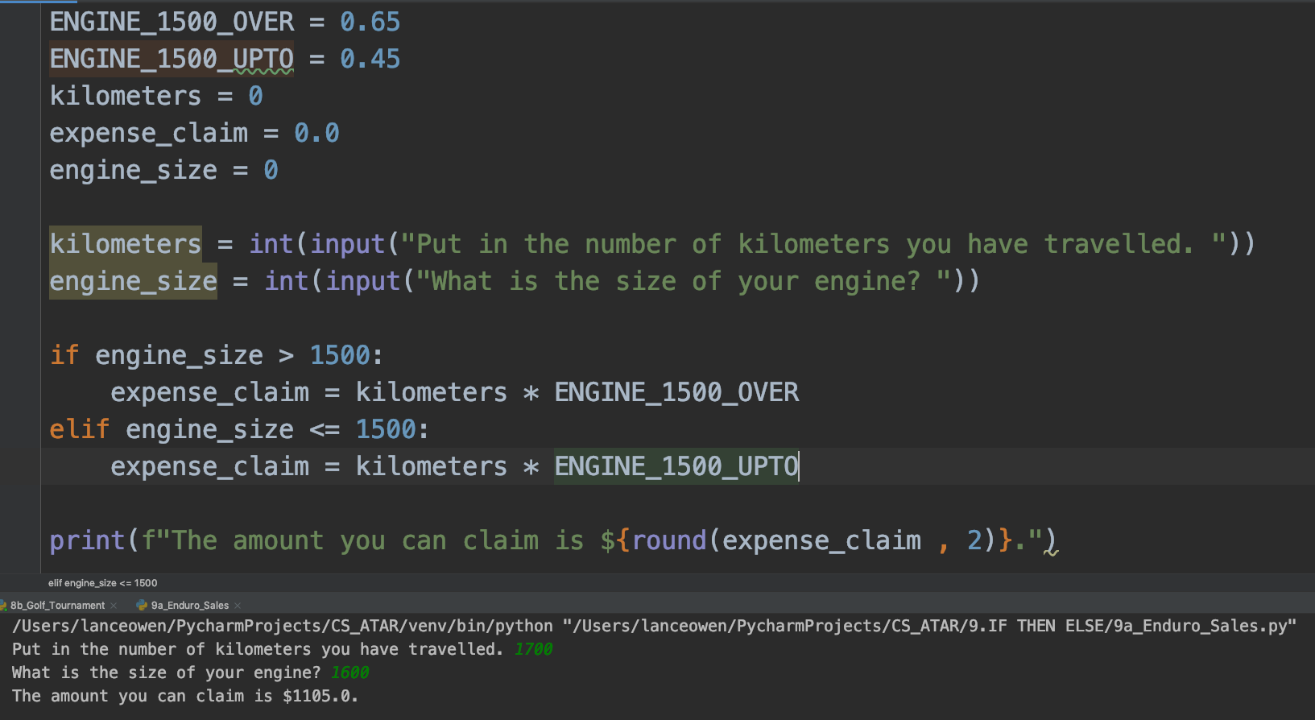
Australian Taxation office
The Australian Taxation office allows some people to claim use of their private car. Cars which have engine capacities 1500 cc and over are allowed 65c per kilometer travelled, while those with engine capacities upto1500 cc are allowed 45c per kilometer because they are smaller. A program is needed to calculate the allowance.

Slide 72
Wages Calculator
You have been contracted to write a Wages Calculator by Freddies Fast Food. Juniors under 18
get $5.60 and hour and the rest get $7.80 an hour. Write the program to caculate the wage of an employee based on the age and number of hours worked in a week.

Slide 73
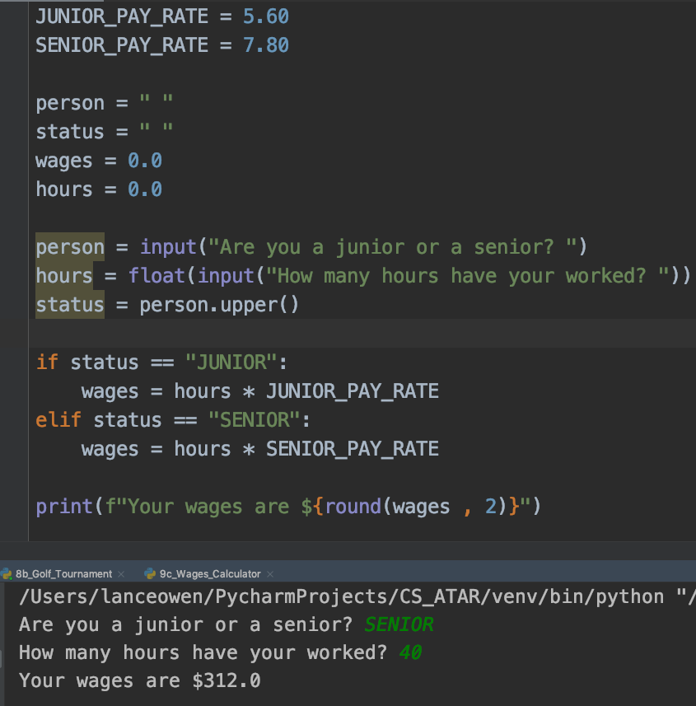
Wages Calculator
Solution

Slide 74
Guessing Game ext
Rewrite the guessing game program so that f a person guesses the wrong number, they will receive
a message telling them they are too high or too low.

Slide 75
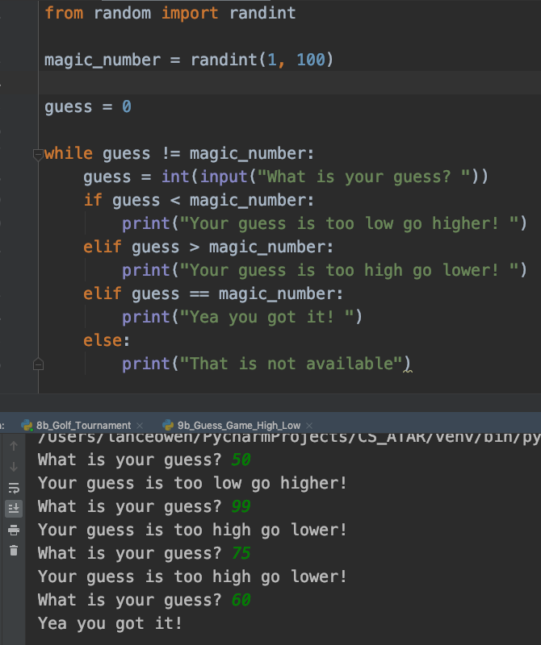
Guessing Game ext
Solution

Slide 76
Western Water Works
The Western Water Works charged $2.45 per kiloliter of water use for the first 100 kiloliters used. Then it
changes to $3.15 for every kiloliter of water used thereafter. Write a program to allow a person to
calculate the amount owing after entereing the amount of water used (in kiloliters).

Slide 77
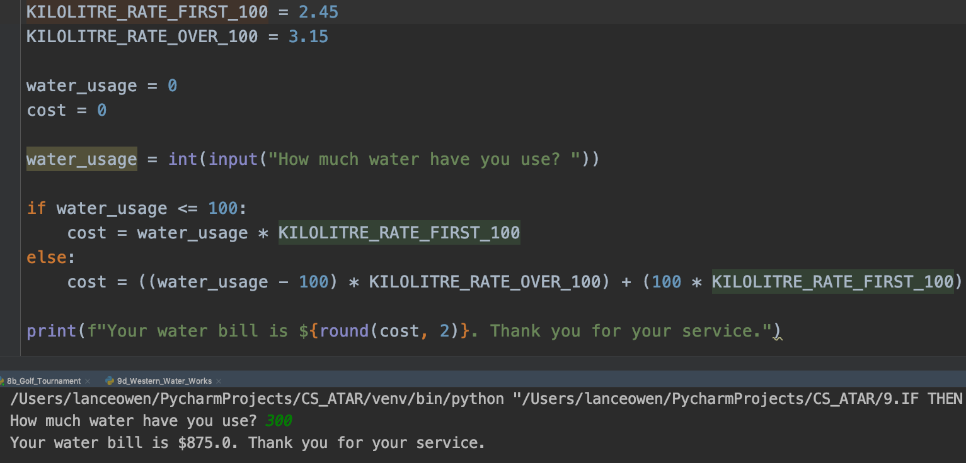
Western Water Works
Solution

Slide 78
Switch
(Case Statement)

Slide 79
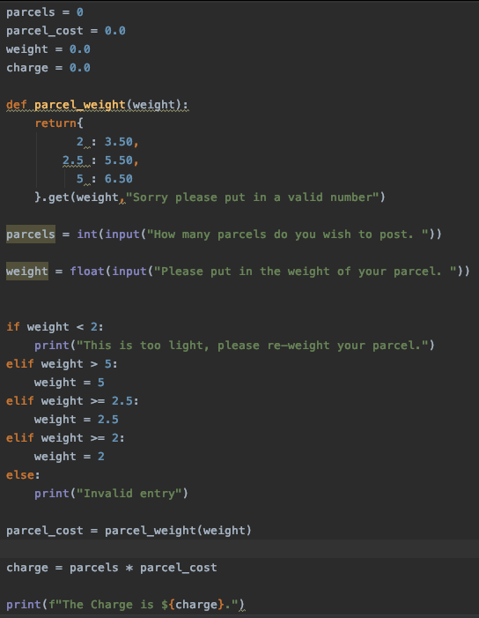
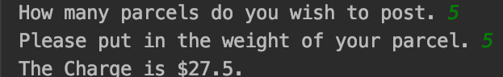
Parcel Post
A program is required that will calculate the cost due when the weight is entered. It is necessary to check to see which category the weight falls in. If Weight is not less than 2, it must be checked again to see whether it is less than 5 or greater than 5. The charge, Charge is calculated based on the final rate

Slide 80
CD Manufacturer
A CD manufacturing company charges multimedia companies $6.50 per CD if they create less
than 1000 copies. If the company required more than 10,000 they only pay $5.00 a copy. Otherwise
they pay $5.70 a copy. Write a program that will allow the company to calculate how much to
Charge for different jobs they do

Slide 81
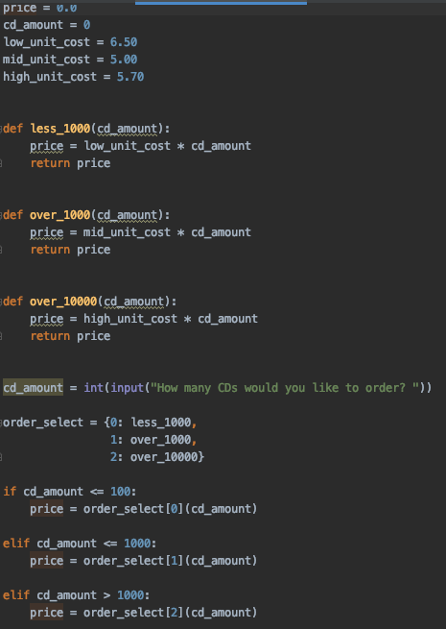
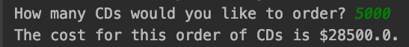
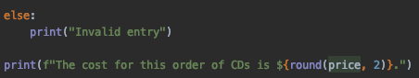
CD Manufacturer
Solution

Slide 82
Income tax
Most countries use a sliding scale income tax program based on the amount of money earned. Write a program to calculate the tax owing on an income of an individuals weekly income.
Income ($) | Tax Payable
0 to 100 | $0
101 to 500 | $0 + 28c per dollar over $100
501 to 1000 | $112 +32c per dollar over $500
1001 to 2000 | 196 + 46c per dollar over $1000

Slide 83
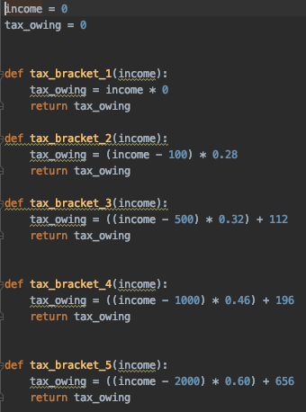
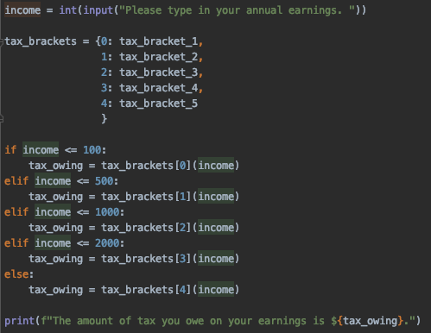
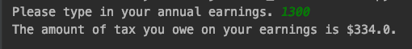
Income tax
Solution

Slide 84
Random Numbers

Slide 85
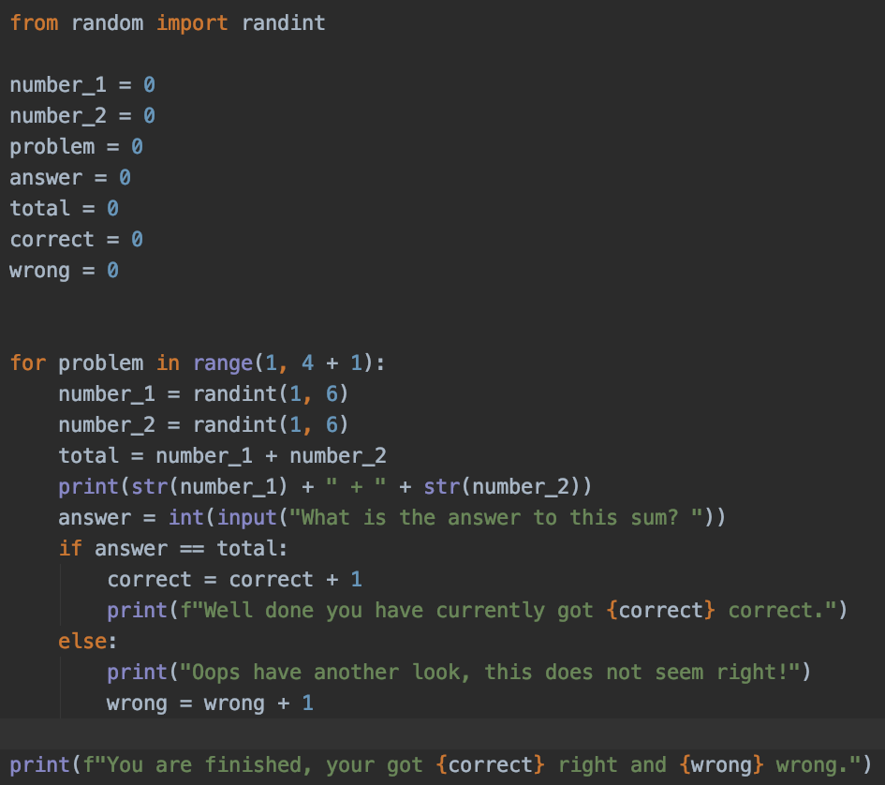

Addition problems
A primary school teacher needs a program that will test a students addition skills. The program generates 4 simple addition problems and determines the number of correct answer.

Slide 86
Dice Throwing
A program is needed to simulate tossing a die 100 times and keeping track of the accumulating total.

Slide 87

Dice Throwing
Solution

Slide 88
Modified Dice Throwing
Modify the program above to show the results of tossing two dice and adding the results.

Slide 89


Modified Dice Throwing
Solution

Slide 90
Two-up Game
The game of two up requires the tossing of two coins. Write a program that will simulate tossing two
coins 100 times and display the results. As an extra challenge, what is the longest run of Heads and
Tails encountered in the 100 tosses

Slide 91


Two-up Game
Solution

Slide 92
Reading a Text File

Slide 93
First step: Open the application ‘TextEdit’
Second step: Copy and past the passage below onto the text file
Third step: Save the file as ’potter.txt’
Fourth step: Put this file into your PyCharm folder
The Dursley family of number four, Privet Drive was the reason that Harry never enjoyed his summer holidays. Uncle Vernon, Aunt Petunia and their son, Dudley, were Harry’s only living relatives. They were Muggles, and they had a very medieval attitude towards magic. Harry’s dead parents, who had been witch and wizard themselves, were never mentioned under the Dursley’s roof. For years, Aunt Petunia and Uncle Vernon had hoped that if they kept Harry as down trodden as possible, they would be able to squash the magic out of him. To their fury, they had been unsuccessful, and now lived in terror of anyone finding out that Harry had spent most of the last two years at Hogwarts School of Witchcraft and Wizardry. The most the Dursleys could do these days was to lock away Harry’s spell books, wand, cauldron and broomstick at the start of the summer holidays and forbid him to talk to the neighbour

Slide 94
Opening a file
Use open() function allows us to tell Python which file we want and what we want to do with it.
The open() function returns a 'file handle’ and does NOT read the text
A handle is something that allows you to get to the file, it is not the file or the data but a wrapper.
fhand = open('potter.txt’)
print(fhand)
This print (fhand) shows the file name, what we are doing with it and character set

Slide 95
Reading a file
fhandle = open('potter.txt') for line in fhandle: print(line)
fhandle.close()
You should close the file so resources on OS can go elsewhere.

Slide 96
Closing the spaces in the text
fhandle = 'potter.txt' with open(fhandle)as filepath: for line in filepath: line = line.rstrip() print(line)
The potter text is open by the handle.
The name ‘filepath is the variable in which the passage of text is put into
For each line in the variable ‘filepath’, it is right stripped
Right stripped means the new line ‘/n’ is taken away so there is no gaps between sentences
Each line is printed

Slide 97
Reading a file one line at a time
fhandle = 'potter.txt' with open(fhandle) as filepath: line = filepath.readline() line = line.rstrip() count = 1 while line: # Condition is TRUE print(f"Line {count}: {line}") line = filepath.readline() line = line.rstrip() count += 1
Text is read into handle
filepath holds the potter .txt
Each line read into line variable
Each line is right striped
Count set to 1,
Prints the count and a single line,
Prints the count and a single line,
readline() function reads one line at a time,
Each line is right stripped
count incremented by one

Slide 98
Reading into an list /array
content = {} with open('potter.txt') as filepath: content = filepath.readlines() content = [line.strip() for line in content] print(content)
Empty list named ‘content’
Open ’potter.txt’ into filepath variable
One line at a time read into ‘content
Each line has space taken away at beginning
and end of sentence.
‘content’ list printed

Slide 99
Lists

Slide 100
What a List can do
x = [1, 2, 'joe', 99] print(len(x)) # Shows number of items in a list
number = [1 , 24 , 76] colour = ['red' , 'yellow' , 'blue’] combined_data ['red' , 24 , 98.6] empty_list = [] print(number)
for i in range(5): print(i, end=', ')
friends = ['Joseph', 'Glenn', 'Sally'] print(friends[1])
lotto = [2, 14, 26, 41, 63] print(lotto) lotto[2] = 28 # Here a new number is being assigned print(lotto)

Slide 101
Adding to a List()
We can create an empty list and then add elements using the append() method The list stays in order and new elements ar eadded at the end of the list stuff = list() # Make me an empty list and assign into stuff stuff.append('book') stuff.append(99) print(stuff) stuff.append('cookie') print(stuff)

Slide 102
numlist = list() while True: inp = input('Enter a number: ') if inp == 'done': break value = float(inp) numlist.append(value) numlist.sort() print(numlist) numlist.sort(reverse=True) print(numlist) average = sum(numlist)/len(numlist) print('Average:', average) print('Average:', round(average, 2))
Example of using a List

Slide 103
Lucky Dot Casinos
You have been contracted by Lucky Dot Casino to produce a simulated program that will
allow a customer to “roll’ two dice. When each die has the same value, the customer wins
a prize. The values of each die are: Plum, Apple, Apricot, Orange, Banana and Pineapple.

Slide 104



Lucky Dot Casinos
Solutions

Slide 105
Mendez
Mendez fish supply has 10 boats that catch fish. Each day, the weight of the bigges fish caught
(in kgs) is sent to the head office. Your task is to write a program that will allow the weight of each
Fish and name of the boat to be recorded (in arrays). The weight of the largest fish is then to be
Determined by searching the array (of weights) and displayed along with the name of the boat
that caught it.
Note: This requires two arrays - on for the weight of the fish and one for the name of the boat

Slide 106


Mendez
Solution

Slide 107
Sentence changing
Write a program that will allow the user to enter the character/word and position of that
component. The result will be a sentence that can be changed programmatically.

Slide 108



Sentence changing
Solution

Slide 109
Palindromes
Palindromes are sentences that say the same thing in either direction – madam i’m adam – is an
example (omitting spaces and other punctuation). You task is to write a program that will take a
sentence – excluding spaces and other punctuation – that will determine if the text makes a palindrome.
Note: Make all test data without spaces and punctuation i.e. madam i’m adam becomes
madamimadam.

Slide 110


Palindromes
Solution

Slide 111
Multiplying arrays
Write a program that will multiply 2 arrays (3 x 3) of numbers.

Slide 112

Multiplying arrays
Solutions

Slide 113
Passing Parameters

Slide 114


Swap
Create a program that will allow the user to enter two words and swap their order.

Slide 115
Values , largest to smallest
Modify the procedure that will accept two values and return them in order of largest to smallest.

Slide 116


Values , largest to smallest
Solution

Slide 117
Formatted Date
Write a procedure that will accept the time ofday in dd/mm/yyyy format and return it
In three different fields of dd, Month and yyyy, i.e. 12/03/2020 would return:
Thursday 12 March 2020

Slide 118


Formatted Date
Solution

Slide 119
Bubble Sort
Write a set of procedures that will allow a list of numbets to be sorted by using the bubble sort method.

Slide 120

Bubble Sort
Solution

Slide 121
Functions

Slide 122


Calculating an area
Pass two measurement of a rectangle into a function and return the area and the perimeter of the rectangle.
You program will allow the calculations of the Area and Perimeter of a rectangle when the length and width are entered.

Slide 123
Calculate circle area and circumference
Create a function which accepts on value for the radius of a circle and returns area and
circumference

Slide 124


Calculate circle area and circumference
Solution

Slide 125
Paired String Values
Write a function that will accept two string values and return a True if they are identical and False if they are not.

Slide 126



Paired String Values
Solution

Slide 127
Exam mark
Write a function that will accept a number value representing a student exam mark between
0 and 100, and return a grade of A, B, C, D or E depending on the exam mark.

Slide 128



Exam mark
Solution

Slide 129
Language Greeting
Create a function that when the parameter of either ‘English’, ‘French’ or 'Indonesian’
It will return the word ‘hello’ in that language.
French is ‘Bonjour’
Indonesian is Apa Kabar

Slide 130

Language Greeting
Solution

Slide 131
Dictionaries

Slide 132
Structure of a dictionary
Dictionaries are like bags with no order. We index things we put in the dictionary with a "lookup tag". Dictionaries are like lists except that they use keys instead of numbers to look up values
Dictionary literals use curly braces and have a list of key: value pairs You can name any empty dictionary using empty curly braces
iii = dict() or iii = {} jjj ={'chuck': 1, 'fred': 42, 'Jan': 100} print(jjj)

Slide 133

How to print out a dictionary
jjj = {'Chuck': 1, 'Fred': 42, 'Jan': 100} print(list(jjj))
print(jjj.keys()) print(jjj.values()) print(jjj.items())

Slide 134


How to loop through a dictionary

Slide 135


Putting it all together

Slide 136


How to create a dictionary

